Slide 1

Terraform
Build, Combine, and Launch Infrastructure

Slide 2
Agenda
What is Terraform?
Why Terraform?
How to install?
State file
Terraform main files
Main commands
Modules
Azure DevOps integration
Q&A

Slide 3

What is Terraform?
Open Source
Written in GO
Created by HashiCorp
Used to script infrastructure just like ARM templates
Supports Azure, AWS, Google Cloud, and others.

Slide 4
Why Terraform?

Slide 5
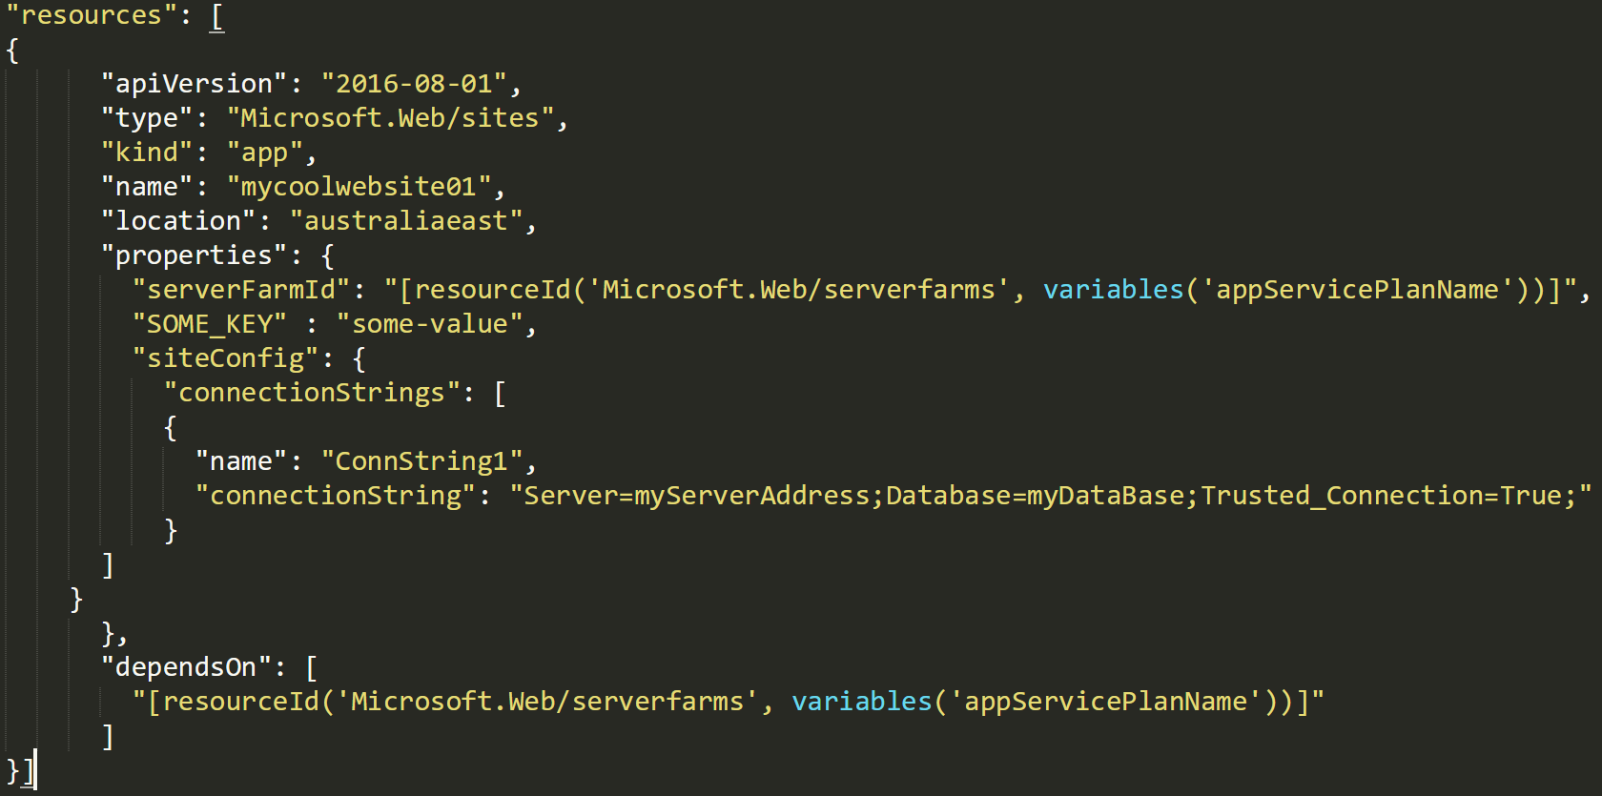
Human readable – ARM 💩

Slide 6
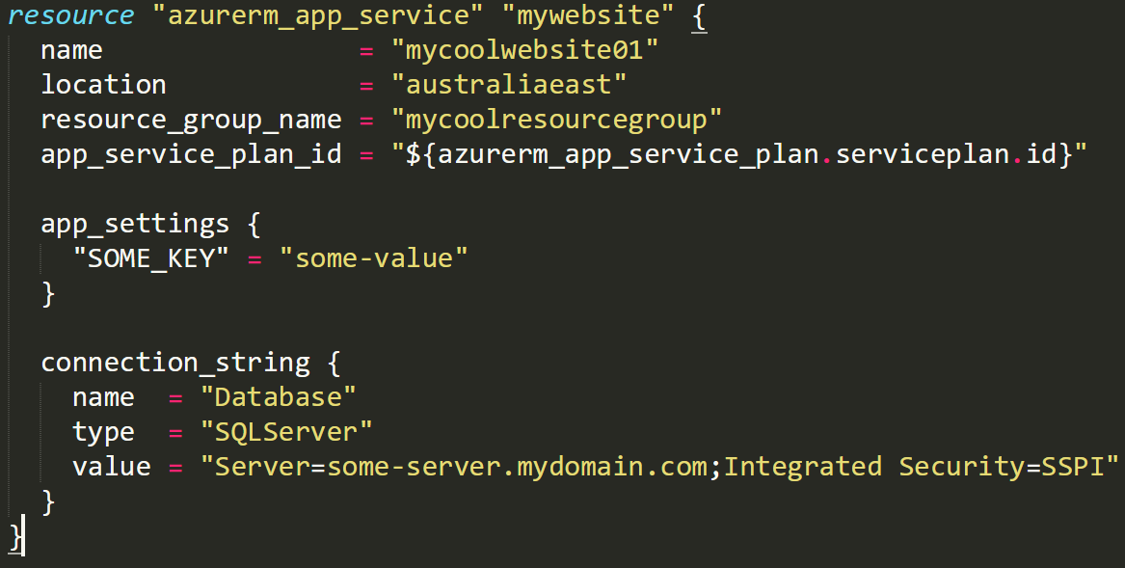
Human readable – Terraform

Slide 7

Tracks changes

Slide 8

How to install?
Windows:
MacOS:
Verify by running terraform in your terminal/PowerShell

Slide 9
State file
Created when you run terraform apply
Saves the current state of your infrastructure
Saved in a file.
The file can be shared in the cloud.

Slide 10
Terraform main files

Slide 11
Resources files
Contains your resources definition
Not mandatory to be a single file (as many files as you like)
Each resource has a set of defined params
Can read variables from variables files
Can easily associate to other defined resources
Notes:
Show them a demo
Show how can you read from var
Show how can you associate to another resource.
Show them how to google any resource type
Talk about VS code

Slide 12
Variables file
Declare the variables with default values
Can be overridden by tfvars files (for each environment)
Contains the information about the backend and provider

Slide 13
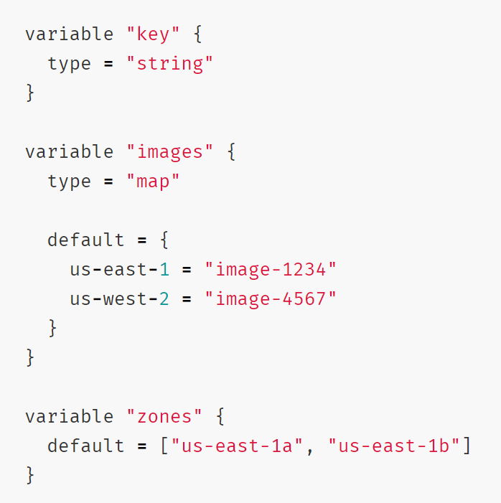
Variables types
Normal
Map
Array
Notes:
https://learn.hashicorp.com/terraform/getting-started/variables.html

Slide 14
Show me something!

Slide 15
Main Commands

Slide 16
Terraform init
Very first command you need to run
Initialize a working directory containing Terraform configuration files
Detects your provider from your code
Downloads a .terraform folder containing provider modules.
Safe to run 100 times
Notes:
Show them a demo
Show how can you read from var
Show how can you associate to another resource.
Show them how to google any resource type
Talk about VS code

Slide 17
Terraform validate
Validates the syntax of the terraform files
Will only return an output if you have syntax issues
Doesn’t check formatting
Notes:
Show them a demo
Show how can you read from var
Show how can you associate to another resource.
Show them how to google any resource type
Talk about VS code

Slide 18
Terraform plan
Creates an execution plan
Makes a diff between what you have in your code and the tfstate file.
Accepts parameters if you want to override variables’ values
Safe to run many times.
Notes:
Show them a demo
Show how can you read from var
Show how can you associate to another resource.
Show them how to google any resource type
Talk about VS code

Slide 19
Terraform apply
Executes the plan that you got when you ran “terraform plan”
Applies the changes required to reach the desired state of the configuration.
Accepts parameters if you want to override variables’ values
Updates the tfstate file
Notes:
Show them a demo
Show how can you read from var
Show how can you associate to another resource.
Show them how to google any resource type
Talk about VS code

Slide 20
Complete Demo

Slide 21
Modules

Slide 22
Modules
Logical separation of your infrastructure
Consider separating your infrastructure if it makes sense
Not mandatory
Notes:
Show them a demo
Show how can you read from var
Show how can you associate to another resource.
Show them how to google any resource type
Talk about VS code

Slide 23
Azure DevOps integration
Install tools from the marketplace.
You can always have a plan, confirmation then Apply.
Notes:
Show them a demo
Show how can you read from var
Show how can you associate to another resource.
Show them how to google any resource type
Talk about VS code

Slide 24
Q&A

